Slide 1
Recommender Systems
Chapter 9
“Machine Learning Using Python”
Manaranjan Pradhan and U Dinesh Kumar
Copyright © 2019 Wiley India Pvt. Ltd. All rights reserved.

Slide 2
OVERVIEW
Recommendation systems are a set of algorithms which recommend most relevant items to users based on their preferences, which are predicted using algorithms.
These algorithms act on behavioral data, such as customer’s previous purchase, ratings or reviews to predict their likelihood of buying a new product or service.
Examples of recommendation systems: Amazon’s “Customers who buy this item also bought”, Netflix’s “Shows and movies you may want to watch”.
Recommender systems are popular for recommending products such as movies, music, news, books, articles and groceries.
Three algorithms widely used for building recommendation systems:
Association Rules 2. Collaborative Filtering 3. Matrix Factorization

Slide 3
ASSOCIATION RULES (ASSOCIATION RULE MINING)
Association rule finds combinations of items that frequently occur together in orders or baskets (in a retail context).
The items that frequently occur together are called itemsets.
Itemsets help discover relationships between items that people buy together and use that as a basis for creating strategies like combining products as combo offer or place products next to each other in retail shelves to attract customer attention.
An application of association rule mining is in Market Basket Analysis (MBA).
MBA is a technique used mostly by retailers to find associations between items purchased by customers.

Slide 4
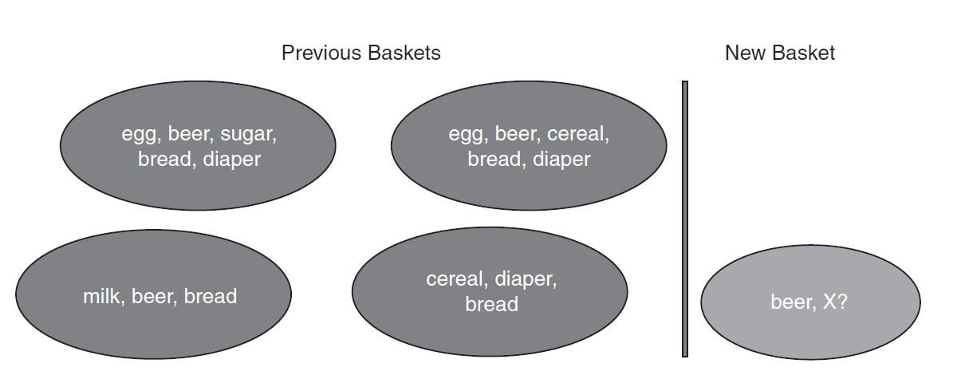
ASSOCIATION RULES (ASSOCIATION RULE MINING) (contd…)
To illustrate the association rule mining concept, let us consider a set of baskets and the items in those baskets purchased by customers:
Items purchased in different baskets are:
Basket 1: egg, beer, sugar, bread, diaper
Basket 2: egg, beer, cereal, bread, diaper
Basket 3: milk, beer, bread
Basket 4: cereal, diaper, bread

Slide 5
COLLABORATIVE FILTERING
Collaborative filtering is based on the notion of similarity (or distance).
Example:
If two users A and B have purchased the same products and have rated them similarly on a common rating scale, then A and B can be considered similar in their buying and preference behavior.
Hence, if A buys a new product and rates high, then that product can be recommended to B. Alternatively, the products that B has already bought and rated high can be recommended to A, if not already bought by A.

Slide 6
COLLABORATIVE FILTERING (contd…)
How to Find Similarity between Users?
Similarity or the distance between users can be computed using the rating the users have given to the common items purchased.
If the users are similar, then similarity measures such as Jaccard coefficient and cosine similarity will have a value closer to 1 and distance measures such as Euclidian distance will have low value.
Most widely used distances or similarities are Euclidean distance, Jaccard coefficient, cosine similarity, and Pearson correlation.

Slide 7
USING SURPRISE LIBRARY
For real-world implementations, we need an extensive library that hides all the implementation details and provides abstract Application Programming Interfaces to build recommender systems. Surprise is a Python library for accomplishing this.
It provides the following features:
Various ready-to-use prediction algorithms like neighborhood methods (user and item similarity), and matrix factorization-based. It has built-in similarity measures such as cosine, mean square distance, Pearson correlation coefficient, etc.
Tools to evaluate, analyze, and compare the performance of the algorithms. It also provides methods to recommend.

Slide 8
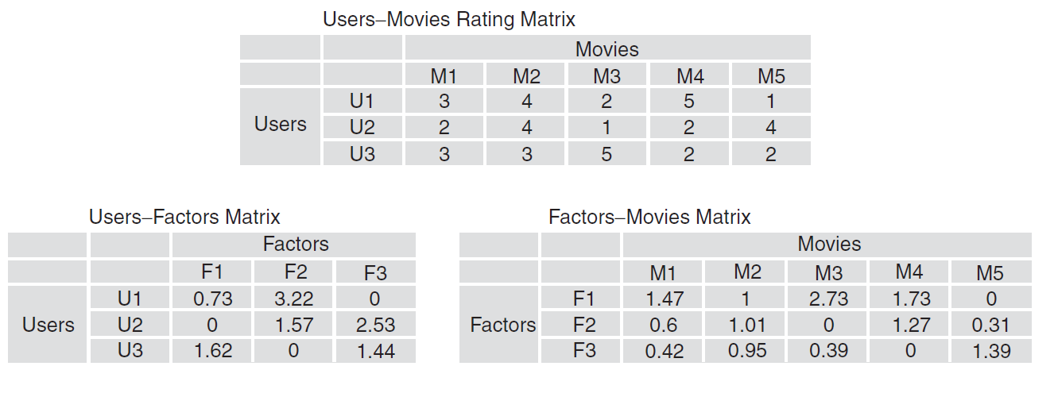
MATRIX FACTORIZATION
Matrix factorization is a matrix decomposition technique.
Matrix factorization algorithms decompose the user-item matrix into the product of two lower dimensional rectangular matrices.
In the Figure, the original matrix contains users as rows, movies as columns, and rating as values. The matrix can be decomposed into two lower dimensional rectangular matrices.

Slide 9
Thank you

